Slide 1
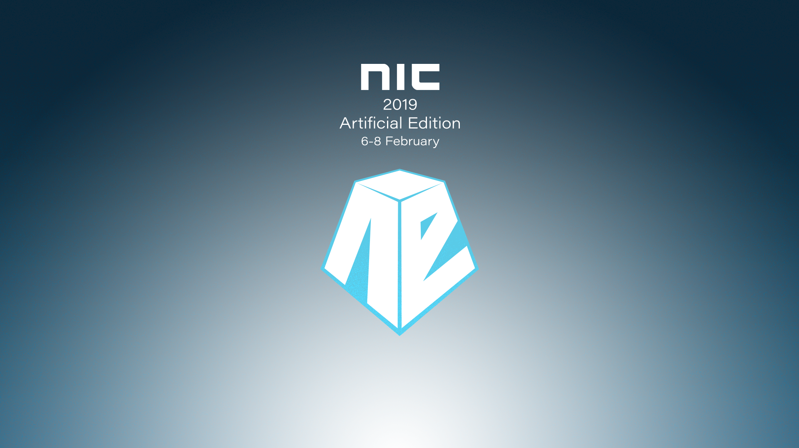
THE ROAD TO TEAMS FROM SHAREPOINT

Slide 2

About me
Jimmy Hang | @Hang_Jimmy | https://hangconsult.com/
Technical Architect – rewired AS, Norway
Microsoft SharePoint Infrastructure
In recent years Office 365, SharePoint Online, OneDrive, Teams

Slide 3
Agenda
Introduction Microsoft 365 Collaboration Apps
SharePoint & Teams
Demo
Governance Tips & Tricks
Q & A

Slide 4
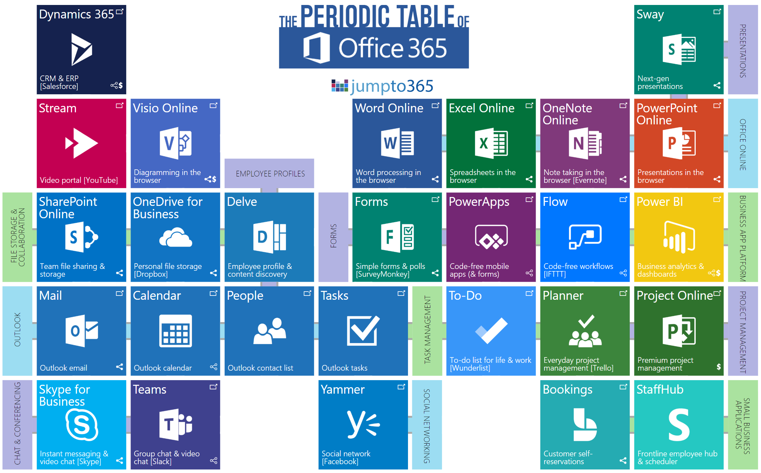
https://beta.jumpto365.com/ | https://beta.jumpto365.com/periodictable/no
Notes:
Matt Wade (MVP)

Slide 5
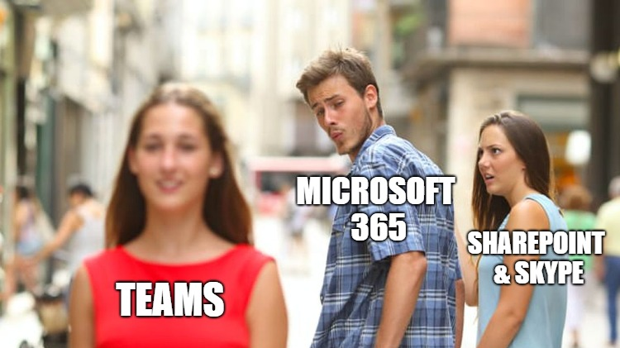

Slide 6
AND
SharePoint
or
Microsoft Teams
?

Slide 7
What is Office 365 Groups? Collection of services
Membership service for M365 teamwork apps
Teams, Outlook, Yammer, SharePoint, Planner, Stream, Forms, StaffHub, Dynamics CRM, Power BI
Office 365 Groups
Centrally managed and governed
Information protection, governance, and compliance,
Azure AD
Extensible
Microsoft Graph, connectors, 3rd party app development

Slide 8

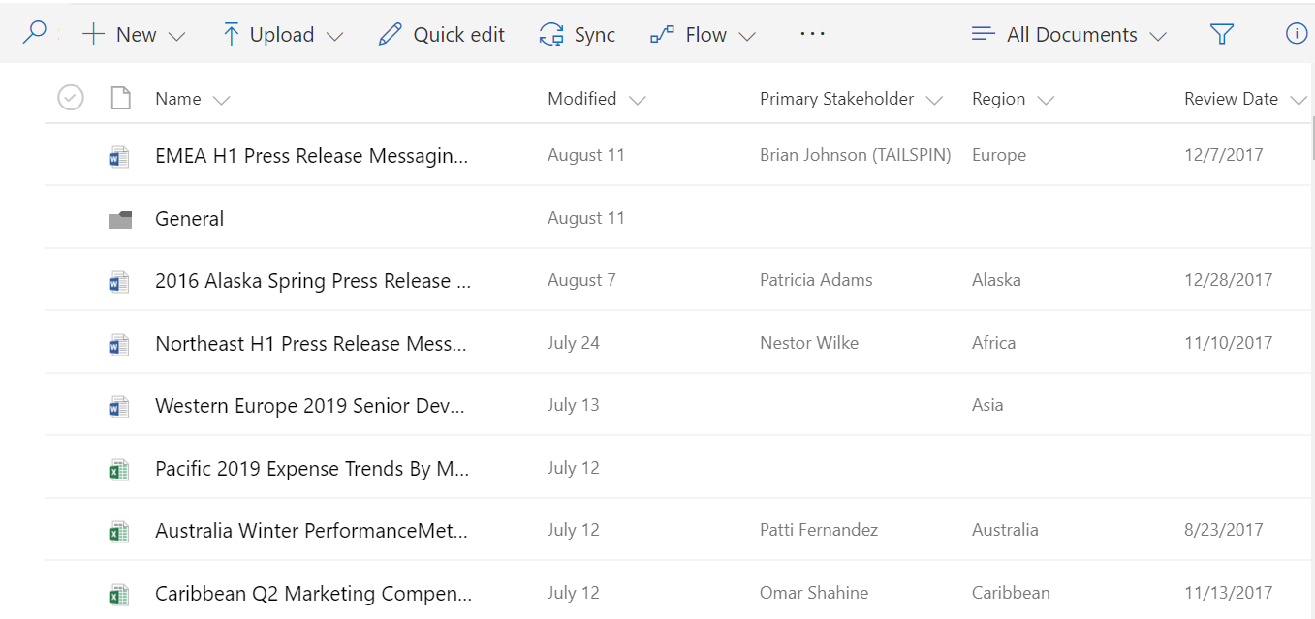
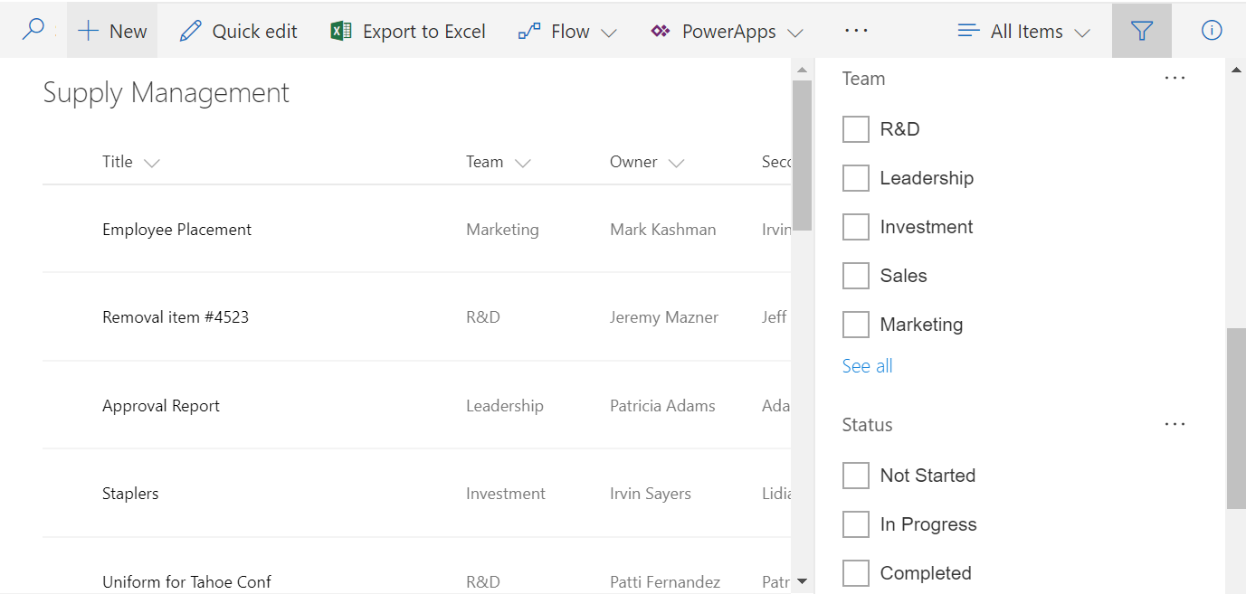
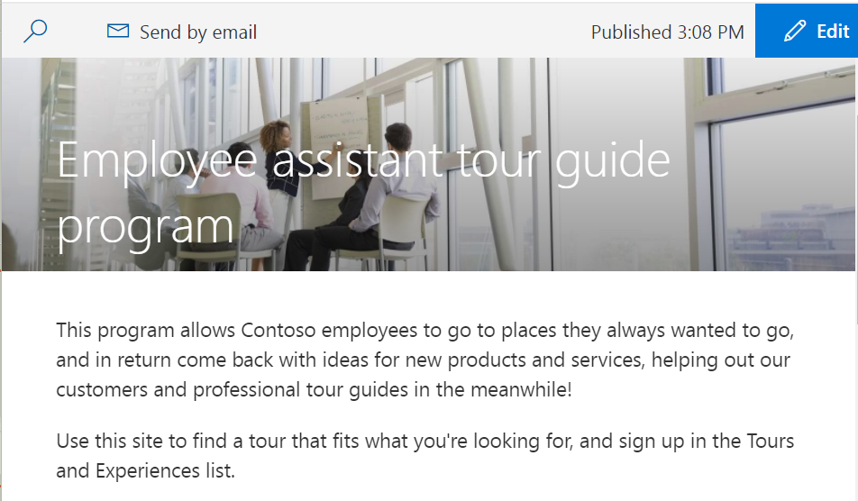
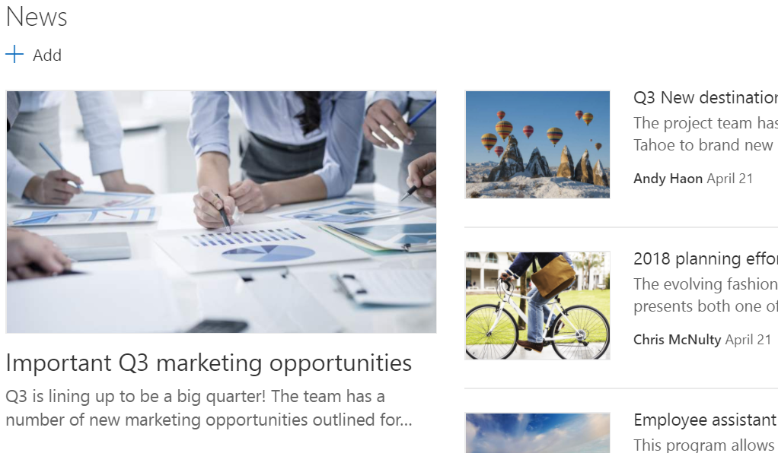
SharePoint
User Roles
Owners
Members
Visitors
Guest
SharePoint Sites
Files
Lists
Portals
News & Pages
Notes:
How many are using SharePoint On-premisses today?
How many are using SharePoint Online Classic today?
How many are using SharePoint Online Modern today?

Slide 9
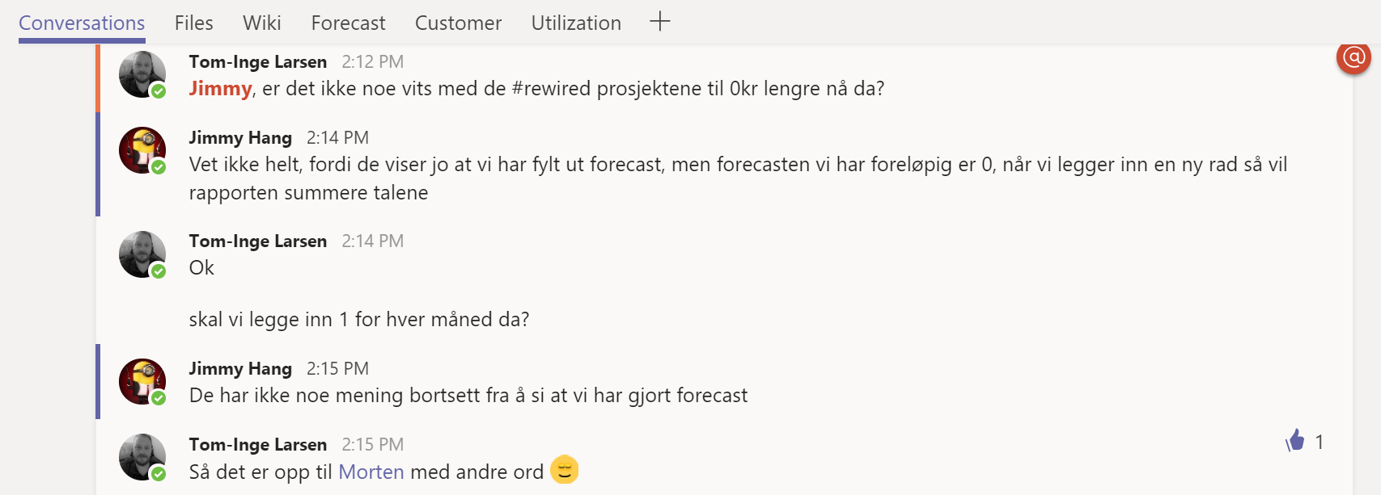
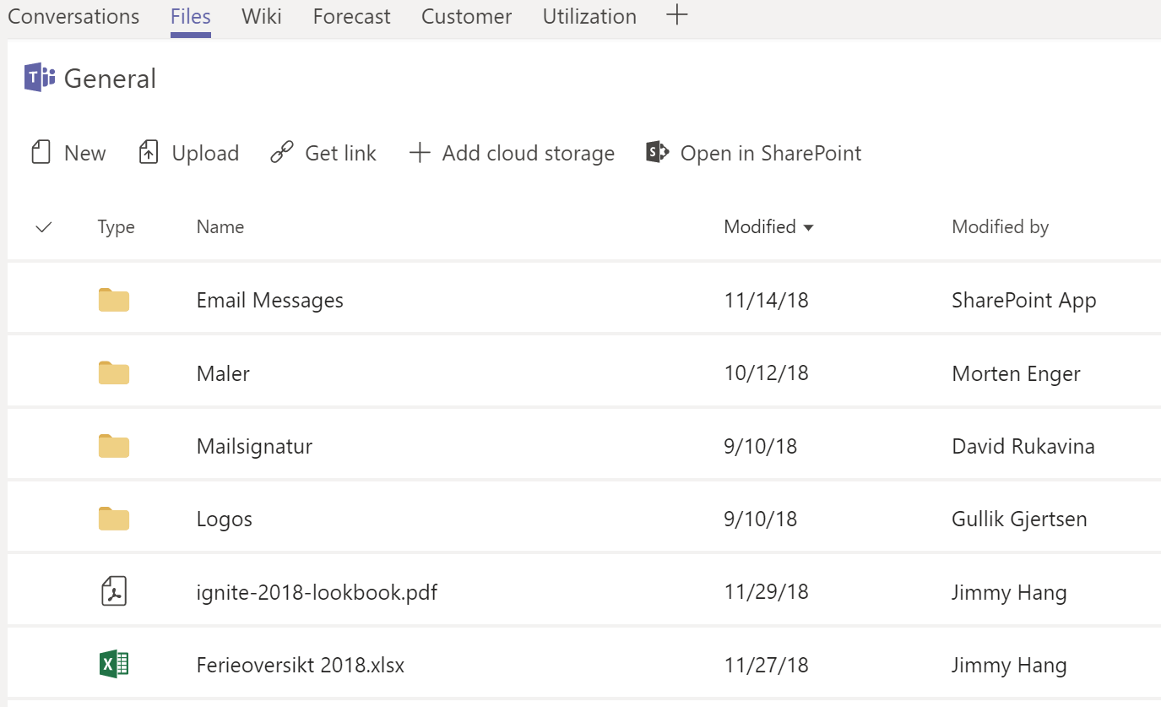
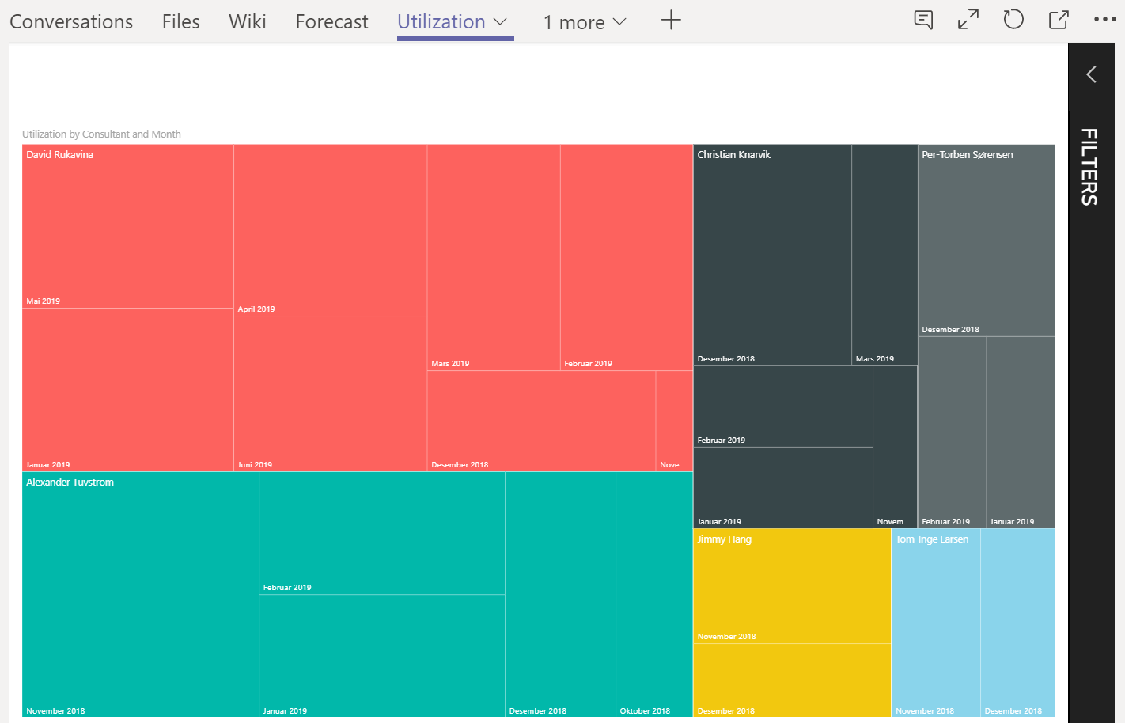
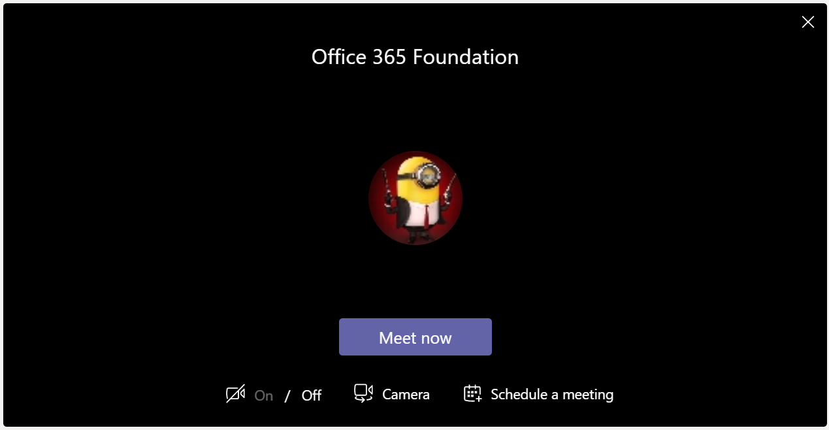
Teams
User Roles
Owners
Members
Guest
Channel Conversations
Files
Tabs
Meeting

Slide 10


Slide 11
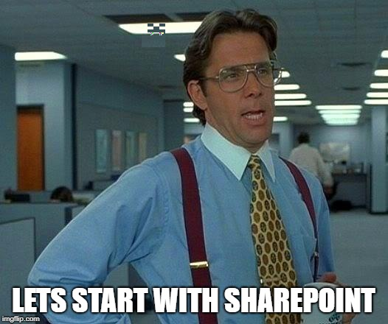
Notes:
Demo Script:
There is 4 main SharePoint site type, Classic Team Site, Sub site, Modern Team Site and Group connected Modern Team Site.
Show the difference between SharePoint Classic and SharePoint Modern
Convert a Classic SharePoint Site to a SharePoint Modern site by creating a new page using PnP
Convert an Exsiting SharePoint Modern site to Group then to Teams
Convert an Existing SharePoint Group site to Teams
Migration of SharePoint 2013 to SharePoint Online using SharePoint Migration tool
Consolidation of Sites
Remember Subsite is a thing of the past, Teams don’t support it
Convert existing folders to Channels

Slide 12
Key Takeaway
Scan your SharePoint site inventory
On-premises
Online
Plan to merge or split existing subsite into Site Collections
Use 3.party migration tools to copy content if needed
Review your existing folder -> chanel in Teams
Review your permissions | avoid broken inheritance

Slide 13

Notes:
Turn on Guest globally
Turn off Guest access for individually Teams
I want to share teamsite document but not teams Conversation & Tabs, share the SharePoint site only

Slide 14
Governance Tips & Tricks
Limit who can create Groups | by default everyone(250) | Admins (500 K)
Prefix, suffix, block word
Private, Public, Org-wide, Guest users
Using dynamic membership in Azure AD | Requires Azure AD P1
Monitor teams usage
Backups retention outside of Office 365
Teams Expiration Policy

Slide 15
Thank You
Q & A
@Hang_Jimmy
https://www.linkedin.com/in/jimmyhang/
https://hangconsult.com

